Slide 1
VIT – AP UNIVERSITY SCHOOL OF COMPUTER SCIENCE AND ENGINEERING STORAGE TECHNOLOGY AND MANAGEMENT (SWE4005) Dr. G. MUNEESWARI PROFESSOR

Slide 2
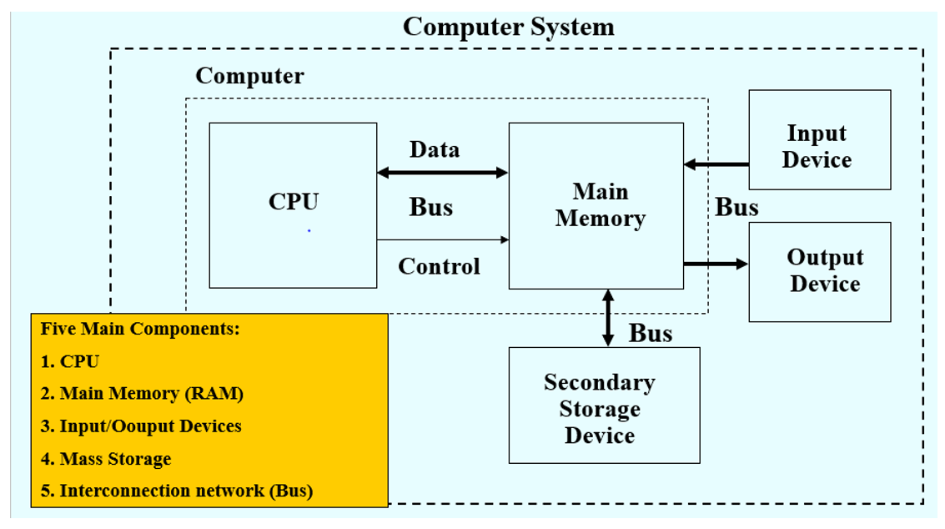
Functional Units of Computer

Slide 3
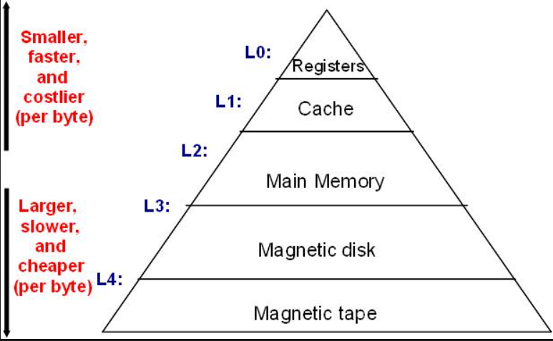
Memory Hierarchy

Slide 4
Why Information Storage
“Digital universe – The Information Explosion”
21st Century is information era
Information is being created at ever increasing rate
Information has become critical for success
We live in an on-command, on-demand world
Example: Social networking sites, e-mails, video and photo sharing website, online shopping, search engines etc
Information management is a big challenge
Organization seek to Store -> Protect -> Optimize -> Leverage the information optimally

Slide 5
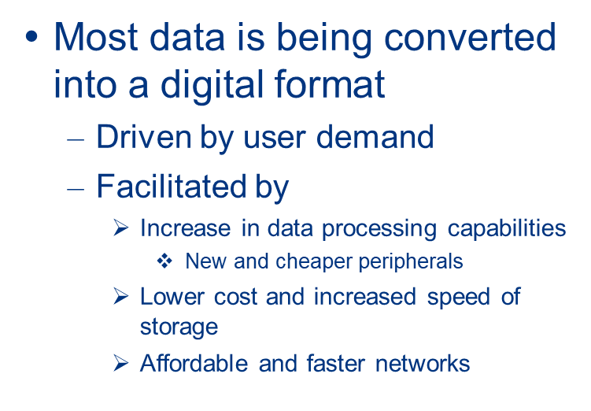
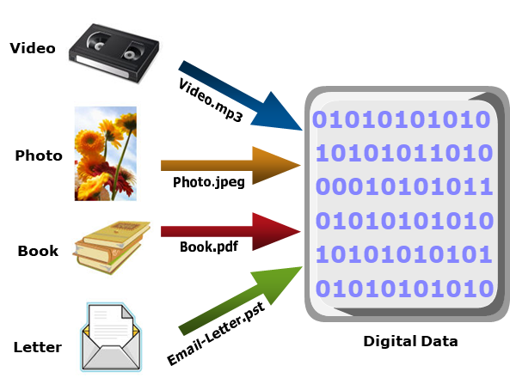
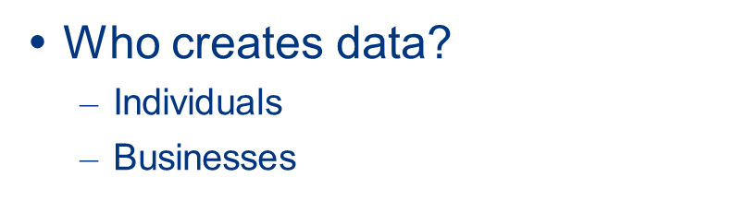
What is Data

Slide 6
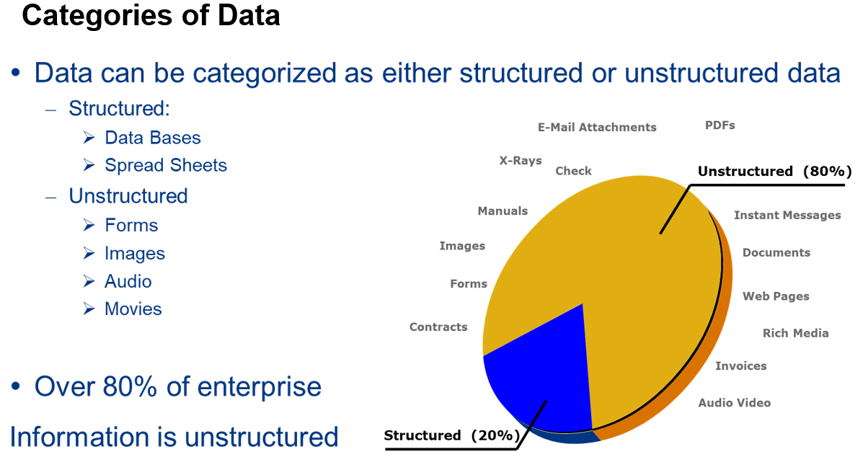

Slide 7
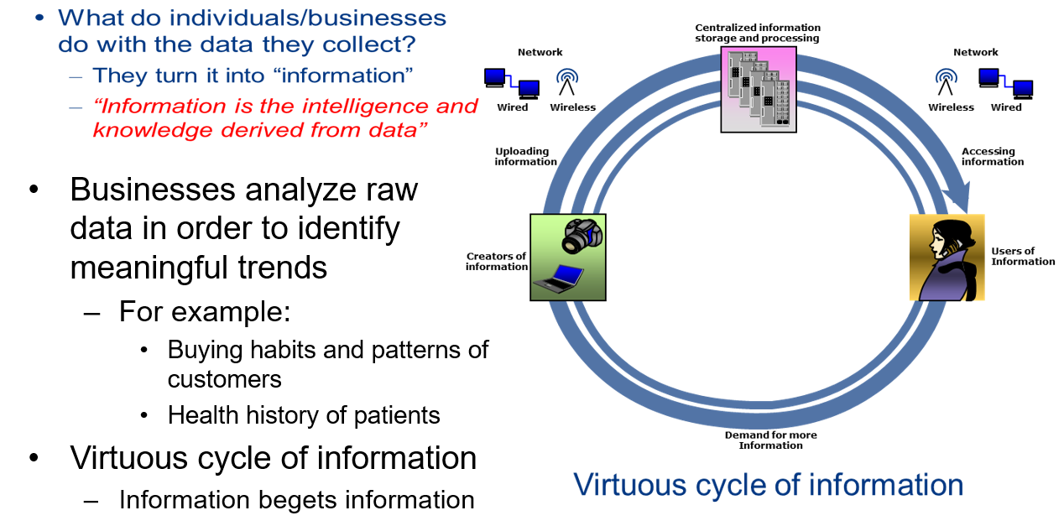
Define Information

Slide 8
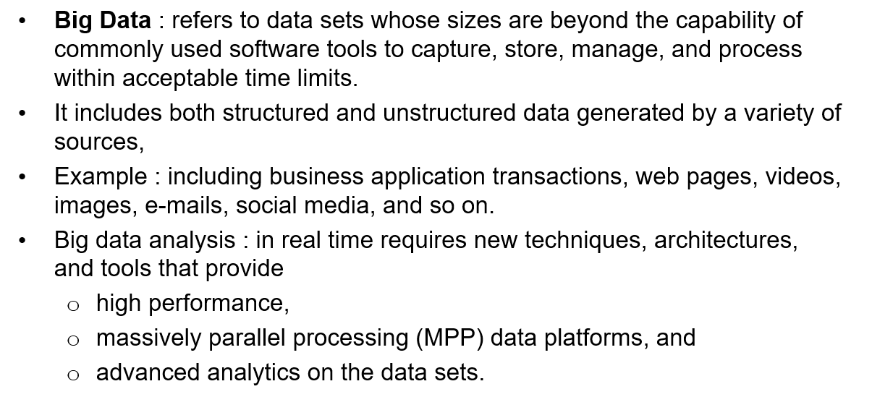
Big Data

Slide 9
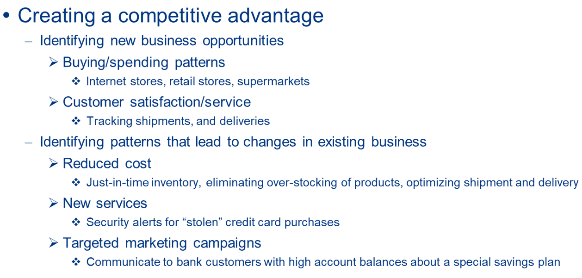
Value of Information to a Business

Slide 10
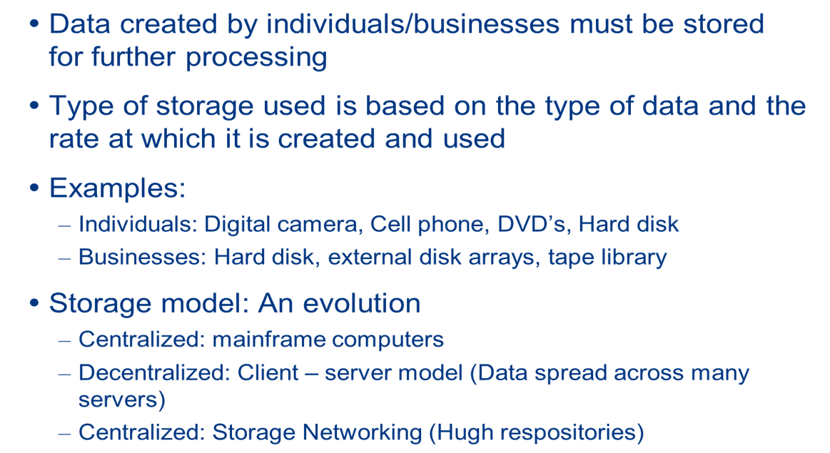
Storage

Slide 11
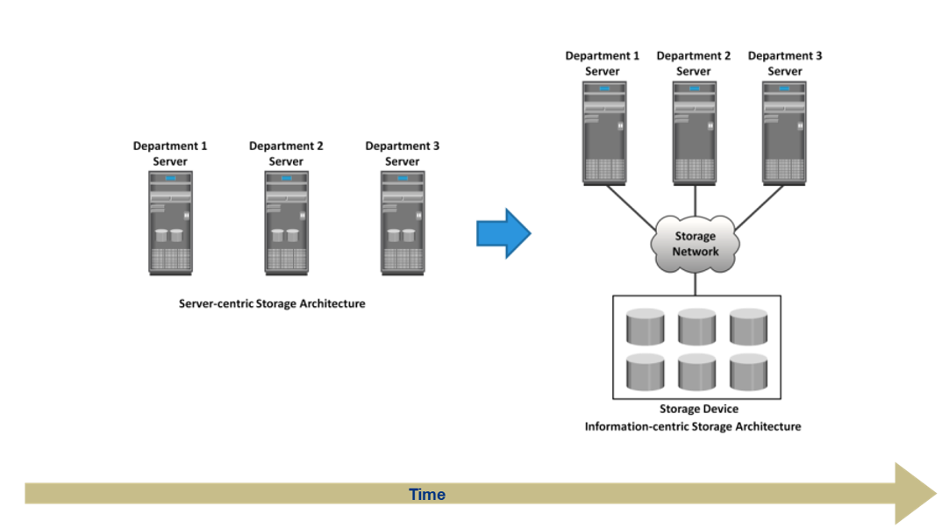
Storage Technology and Architecture Evolution

Slide 12
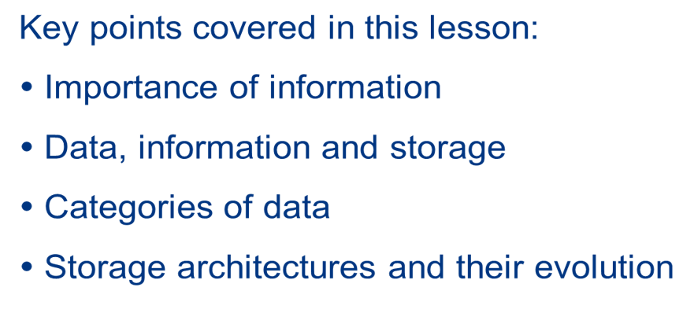
Summary

